Slide 1
Informatica Capabilities As An ETL Tool
View Informatica PowerCenter 9.X Developer & Admin course at http://www.edureka.co/informatica
For more details please contact us:
US : 1800 275 9730 (toll free)
INDIA : +91 88808 62004
Email Us : webinars@edureka.co
For Queries:
Post on Twitter @edurekaIN: #askEdureka
Post on Facebook /edurekaIN

Slide 2
Objectives
At the end of this module, you will be able to:
Understand Informatica & Informatica Product Suite
Understand Informatica PowerCenter Designer
Work With PowerCenter Workflow Manager
Implement Aggregation & Sorting in Informatica

Slide 3



Common Challenges in Data Integration
Rising Complexity of Data
Increasing Business Demands
The Dirty Data
Cost Effective and High Standard Enterprise Data Integration

Slide 4
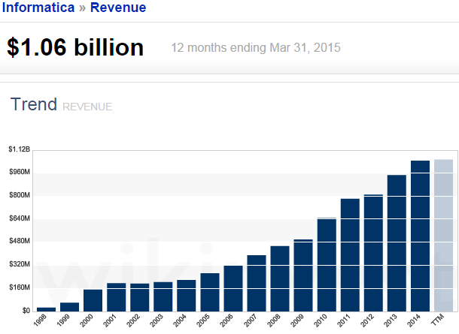
Informatica – A Product Company
Informatica Corp. provides data integration software and services for various businesses, industries and government organizations including telecommunication, health care, financial and insurance services
Founded : 1993
2015 Revenue : $1.06 billion
7-year Annual CAGR: 30% per year
Employees : 5,500+
Partners : 450+
Major SI, ISV, OEM and On-Demand Leaders
Customers: Over 5,000
Customers in 82 countries
Direct Presence in 28 countries
# 1 in Customer Loyalty Rankings
(7 Years in a Row)
Notes:
Title and Content Slide – Font: Tahoma 12/14 (depending on the amount of text)
Heading: Calibri Heading 26 (consistent)
Bullet code – 174 for bullet
OOBB for sub bullet

Slide 5
Informatica Products & Their Functionalities
There are a wide range of products available under the Informatica product suite that helps satisfy the data integration requirements within the enterprise and beyond
Informatica's product is a portfolio focused on Data Integration:
Data Integration & ETL
Information Lifecycle Management
Complex Event Processing
Data Masking
Data Quality
Data Replication
Data Virtualization
Master Data Management
Ultra Messaging
Currently at version 9.6, these components form a toolset for establishing and maintaining enterprise-wide data warehouses
Notes:
Title and Content Slide – Font: Tahoma 12/14 (depending on the amount of text)
Heading: Calibri Heading 26 (consistent)
Bullet code – 174 for bullet
OOBB for sub bullet

Slide 6
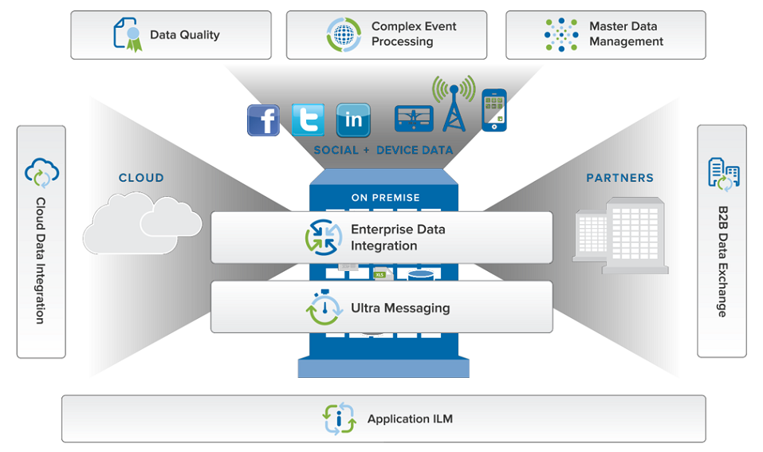
Informatica Products & Their Functionalities (Contd.)
Notes:
Title and Content Slide – Font: Tahoma 12/14 (depending on the amount of text)
Heading: Calibri Heading 26 (consistent)
Bullet code – 174 for bullet
OOBB for sub bullet

Slide 7
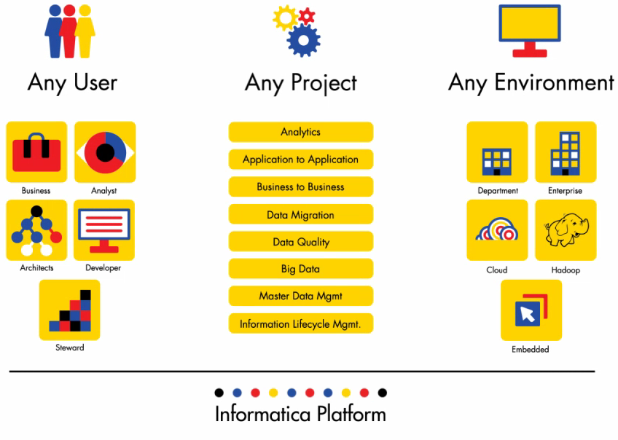
Informatica Products & Their Functionalities (Contd.)
Notes:
Title and Content Slide – Font: Tahoma 12/14 (depending on the amount of text)
Heading: Calibri Heading 26 (consistent)
Bullet code – 174 for bullet
OOBB for sub bullet

Slide 8
Informatica Products & Their Functionalities (Contd.)
PowerCenter - Fully integrated end-to-end data integration platform, Informatica PowerCenter Enterprise converts raw data into information to drive analysis, daily operations, and data governance initiatives
Information Lifecycle Management - Informatica’s Information Lifecycle Management software empowers your IT organizations to cost-effectively handle data growth, safely retire legacy systems and applications, optimize test data management and protect sensitive data
Complex Event Processing - Informatica RulePoint is a complex event processing software that delivers robust and effective complex event processing with real-time alerts and insight into pertinent information to operate in a smarter, faster, efficient and competitive way
Data Masking - Informatica Data Masking products dynamically mask sensitive production data from unauthorized access, permanently and irreversibly mask nonproduction data thereby helping IT organizations to comply with data privacy regulations, organization-wide data privacy mandates and reduce the risk of a data breach
Notes:
Title and Content Slide – Font: Tahoma 12/14 (depending on the amount of text)
Heading: Calibri Heading 26 (consistent)
Bullet code – 174 for bullet
OOBB for sub bullet

Slide 9
Informatica Products & Their Functionalities (Contd.)
Data Quality - Informatica Data Quality provides clean, high-quality data regardless of size, data format, platform, or technology to the business. Helps validating and improving address information, profiling and cleansing business data, or implementing a data governance practice and ensure the data quality requirements are met
Data Replication - Informatica Data Replication is database-agnostic, real-time transaction replication software that’s highly scalable, reliable, and non-disruptive to the performance of operational source systems
Data Virtualization - Informatica Data Services provides a single scalable architecture for both data integration and data federation, creating a data virtualization layer that hides and handles the complexity of accessing underlying data sources - all while insulating them from change
Master Data Management - The Informatica Master Data Management (MDM) product family delivers consolidated and reliable business-critical data—also known as master data—to the applications that employees rely on every day
Ultra Messaging - Informatica Ultra Messaging is a family of next-generation, low-latency messaging middleware products. With very high throughput and 24x7 reliability, they deliver extremely low-latency application messaging over both network-based and shared-memory (inter-process) based transports
Notes:
Title and Content Slide – Font: Tahoma 12/14 (depending on the amount of text)
Heading: Calibri Heading 26 (consistent)
Bullet code – 174 for bullet
OOBB for sub bullet

Slide 10
Introduction to PowerCenter
PowerCenter:
It is a single, unified enterprise data integration platform that allows companies and government organizations of all sizes to access, discover and integrate data from virtually any business system, in any format and deliver that data throughout the enterprise at any speed
An ETL tool ( Extract, Transform and Load)
The main advantages of PowerCenter over other ETL tools lies in its robustness, for it can be used in both Windows and Unix based systems
PowerCenter can read from a variety of different sources and write to as many targets, while transforming data in between
The main advantages of PowerCenter over other ETL tools, and hence a reason for its popularity over other such tools are as follows:
It is robust, and can be used in both windows and UNIX based systems
It is high performing yet very simple for developing, maintaining and administering

Slide 11
Versions of PowerCenter
PowerCenter Version History:
The current version of PowerCenter is Informatica PowerCenter 9.6.1 HF2 (as of Feb ’15)
From version 9.x onwards, PowerCenter has become service oriented, with each server component being identified as a service. (Ex.: Repository service, Integration service etc.)
The previous versions of Informatica are neither in use nor under support of Informatica
For more information please visit www.informatica.com

Slide 12
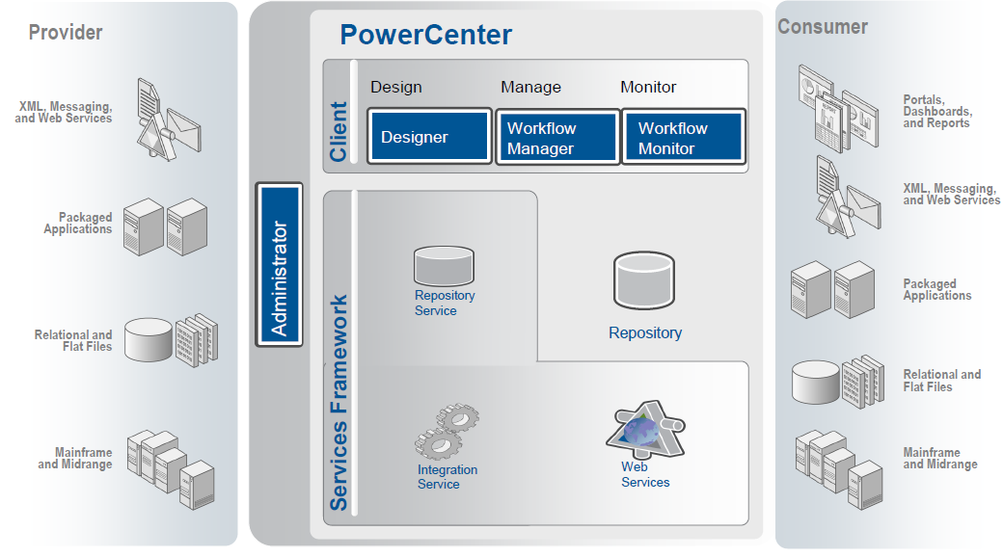
PowerCenter Architecture - Single Unified Architecture

Slide 13
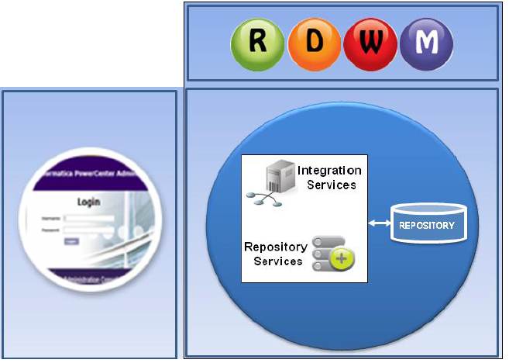
Overview of PowerCenter Architecture
The PowerCenter tool consists of :
Client components
Server components
Notes:
PowerCenter is based on the client-server architecture. Clients’ components are mainly used to develop, execute, monitor, and administer different objects. The server components are responsible for establishing connectivity and execution of the data movement.
The PowerCenter client consists of designer, repository manager, workflow manager, and workflow monitor tools. It also includes the web browser-based Admin Console for all kinds of administrative tasks.
The server components include the integration service, repository service, and the repository itself. The repository stores all the PowerCenter metadata.
Repository and integration services interact with the Repository. The interaction happens at the time of any request is made through any of the client components.
All these tools are described in the subsequent slides.

Slide 14





Client Components of PowerCenter
PowerCenter Repository Manager
PowerCenter Designer
PowerCenter Workflow Manager
PowerCenter Workflow Monitor
PowerCenter Administration Console (browser based)
Notes:
We can get a detailed description of each client component.
PowerCenter Repository Manager is used to navigate through the multiple folders and repositories. It performs the basic repository tasks as well.
PowerCenter Designer is a client component which contains some tools that helps to build mappings. These are the basic Informatica objects where the movement of data is defined. The Designer is used to create the source definitions, target definitions, and transformations to build the mappings.
PowerCenter Workflow Manager is used to define a set of instructions called a workflow. Such instructions help to execute mappings built in the Designer.
PowerCenter Workflow Monitor helps to monitor the execution of the workflows.
PowerCenter Administration Console is the administration tool, which is used to direct the PowerCenter domain. The Administration Console performs various administrative tasks, such as managing logs, user accounts, and domain objects. Domain objects include services, nodes, and folders.

Slide 15
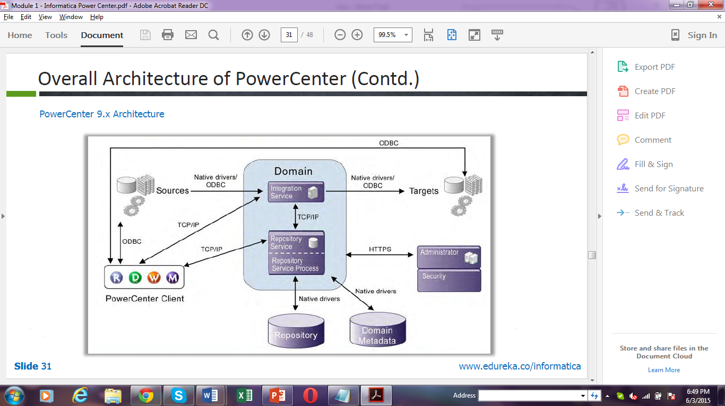
Overall Architecture of PowerCenter
PowerCenter 9.x Architecture
Notes:
The figure above is meant to help understand the terms explained in the previous slide as well as show how they are interrelated to each other.
It must be remembered here that every PowerCenter environment consists of at least one domain for centralized administration.

Slide 16
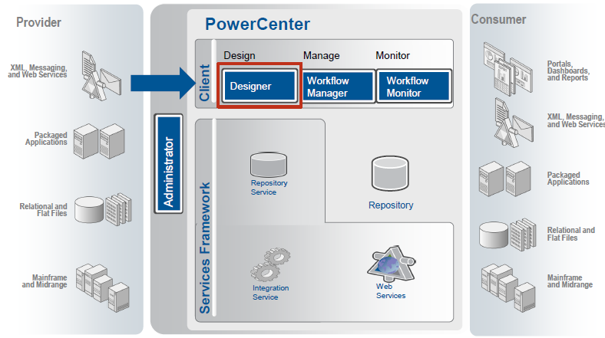
Designer Overview
The PowerCenter Designer is the client where we specify how to move the data between various sources and targets
This is where we interpret the various business requirements by using different PowerCenter components called transformations, and pass the data through them (transformations)
The Designer is used to create source definitions, target definitions, and transformations, that can be further utilized for developing mappings
Notes:
Title and Content Slide – Font: Tahoma 12/14 (depending on the amount of text)
Heading: Calibri Heading 26 (consistent)
Bullet code – 174 for bullet
OOBB for sub bullet

Slide 17
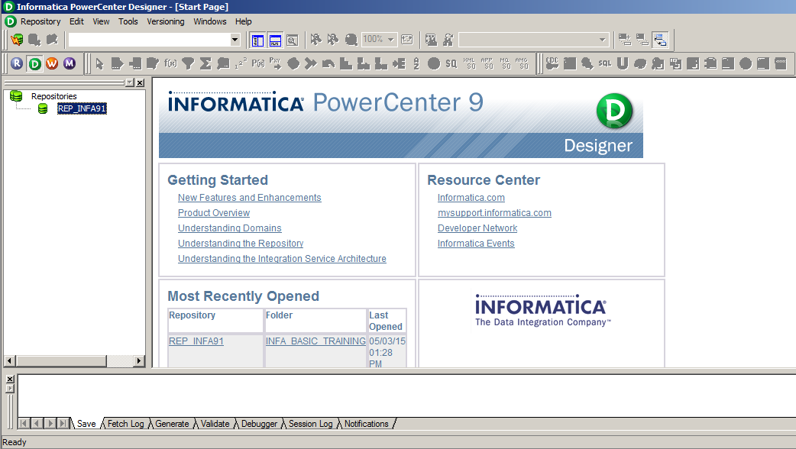
Opening the Designer
To open the Designer, follow the path shown below:
Start > All Programs > Informatica 9.5.1 > Client > PowerCenter Client > PowerCenter Designer
Notes:
•This screen shows the sequence of steps for opening the PowerCenter Designer from the Start Menu. Select All Programs under Start Menu and then choose 'Informatica PowerCenter 9.5.1' under that. Then, you can view the PowerCenter Designer image. Next, open the PowerCenter Designer Tool and a new box will appear which is referred to as a Designer Window. The left pane within the Designer window is called the Navigator window. It shows the list of the repositories that can be connected. You can add or remove repositories from this list. Then, another box will appear as a Designer Window. The bottom part of the window is the Output Window that displays the repository notifications.

Slide 18
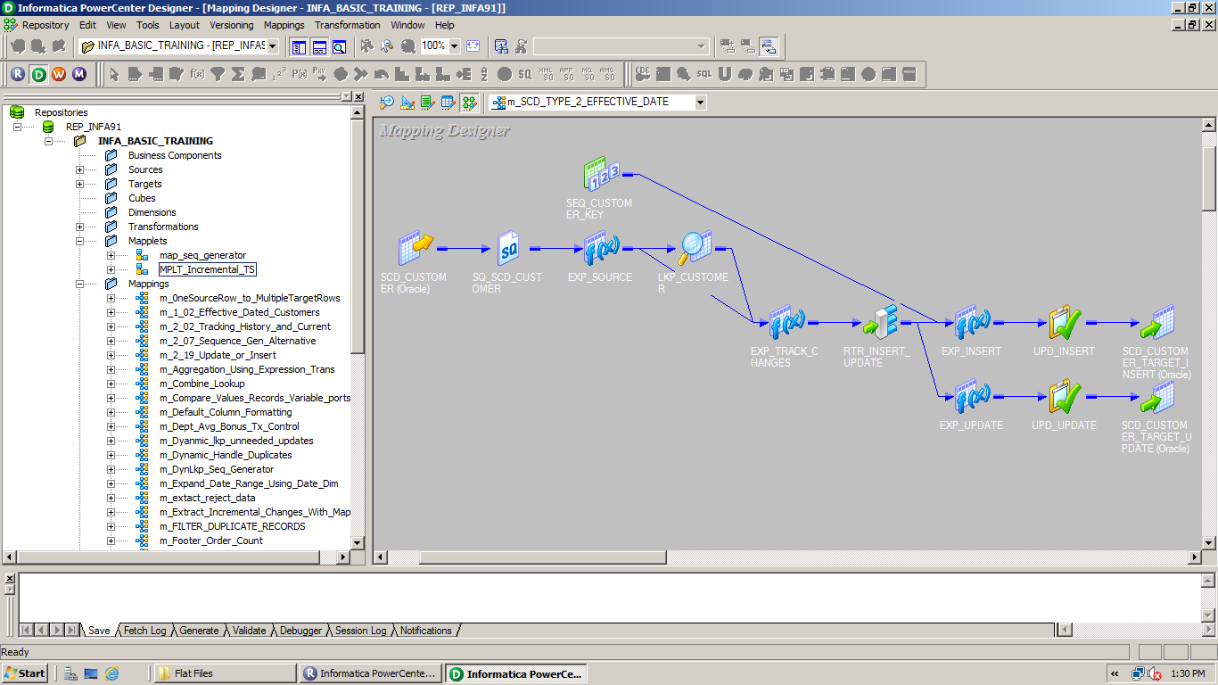
PowerCenter Designer
Provides tools to define and manipulate
Sources
Targets
Transformations
Mappings
Other objects
Notes:
Used to create mappings that logically define what is to be done and how. Mappings define the sources, the targets and the transformations that you want to perform on the data all through a graphical drag and drop environment.

Slide 19
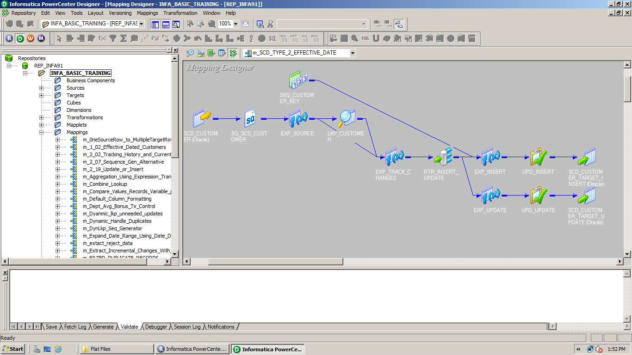
PowerCenter Designer- Interface
Folder List
Mapping List
Transformation Toolbar
Iconized Mapping

Slide 20
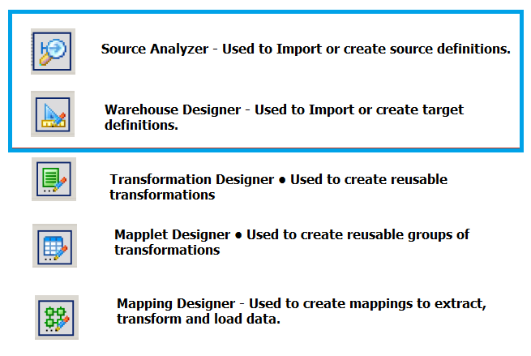
Designer Tools
The Designer provides the following tools:
Source Analyzer. Import or create source definitions for flat file, XML, COBOL, Application, and relational sources
Target Designer. Import or create target definitions
Transformation Developer. Create reusable transformations
Mapplet Designer. Create mapplets
Mapping Designer. Create mappings
Notes:
Title and Content Slide – Font: Tahoma 12/14 (depending on the amount of text)
Heading: Calibri Heading 26 (consistent)
Bullet code – 174 for bullet
OOBB for sub bullet

Slide 21
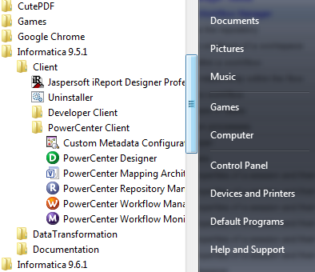
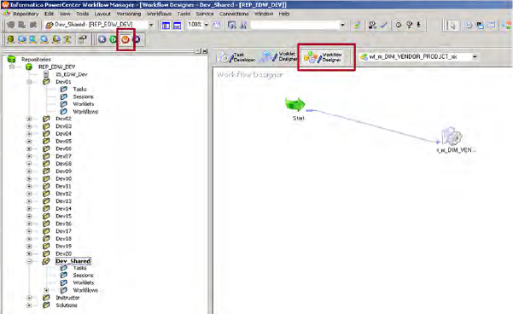
Workflow Manager
The Workflow Manager is the PowerCenter application that enables designers to build and run Workflows
Can be launched from Designer by clicking the “W” icon
Can be opened independently from the path Start > All Programs > Informatica PowerCenter 9.5.1 > Client > PowerCenter Client > PowerCenter Workflow Manager
The Workflow Designer -The tool you use to create Workflow objects
Notes:
Title and Content Slide – Font: Tahoma 12/14 (depending on the amount of text)
Heading: Calibri Heading 26 (consistent)
Bullet code – 174 for bullet
OOBB for sub bullet

Slide 22
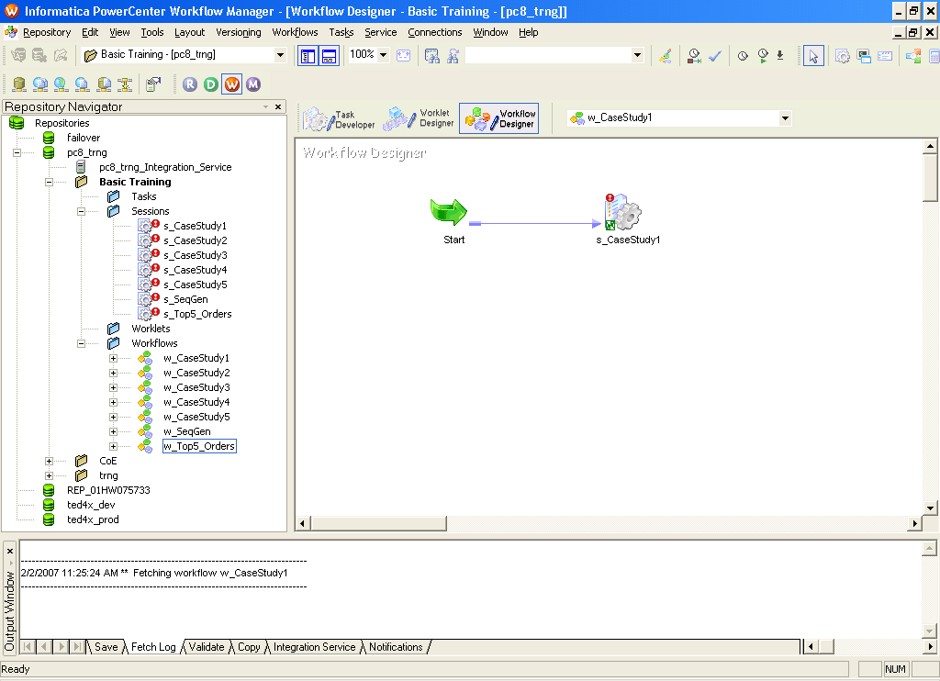
Workflow Manager Interface
Tasks
Connections
Workflow Designer
Tools
Client Applications
Workspace
Navigator Window
Output Window
Status Bar
Notes:
Title and Content Slide – Font: Tahoma 12/14 (depending on the amount of text)
Heading: Calibri Heading 26 (consistent)
Bullet code – 174 for bullet
OOBB for sub bullet

Slide 23
Workflow Manager Interface (Contd.)
The Workflow Manager displays the following windows to help you create and organize workflows:
Navigator. You can connect to and work in multiple repositories and folders. In the Navigator, the Workflow Manager displays a red icon over invalid objects.
Workspace. You can create, edit, and view tasks, workflows, and worklets.
Output. Contains tabs to display different types of output messages. The Output window contains the following tabs:-
Save. Displays messages when you save a workflow, worklet, or task. The Save tab displays a validation summary when you save a workflow or a worklet.
Fetch Log. Displays messages when the Workflow Manager fetches objects from the repository.
Validate. Displays messages when you validate a workflow, worklet, or task.
Copy. Displays messages when you copy repository objects.
Server. Displays messages from the Integration Service.
Notifications. Displays messages from the Repository Service.
The Workflow Manager also displays a status bar that shows the status of the operation you perform.
Notes:
Title and Content Slide – Font: Tahoma 12/14 (depending on the amount of text)
Heading: Calibri Heading 26 (consistent)
Bullet code – 174 for bullet
OOBB for sub bullet

Slide 24

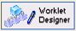
Workflow Manager Tools
Workflow Designer - Maps the execution order and dependencies of Sessions, Tasks and Worklets, for the Informatica Server
Task Developer
Create Session, Shell Command and Email tasks
Tasks created in the Task Developer are reusable
Worklet Designer
Creates objects that represent a set of tasks
Worklet objects are reusable
Notes:
To create a workflow, you first create tasks such as a session, which contains the mapping you build in the Designer. You then connect tasks with conditional links to specify the order of execution for the tasks you created. The Workflow Manager consists of three tools to help you develop a workflow:
•Task Developer. Use the Task Developer to create tasks you want to run in the workflow.
•Workflow Designer. Use the Workflow Designer to create a workflow by connecting tasks with links. You can also create tasks in the Workflow Designer as you develop the workflow.
•Worklet Designer. Use the Worklet Designer to create a worklet.

Slide 25
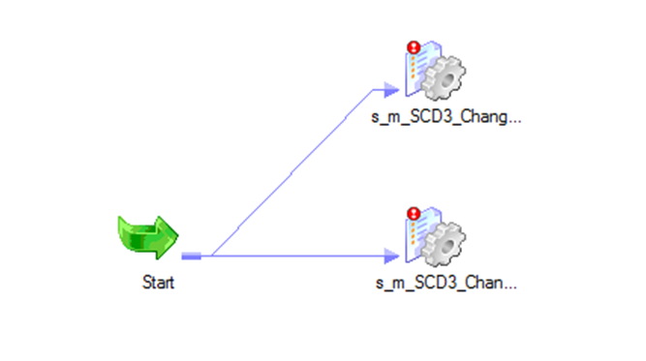
Example of a Workflow
The following figure illustrates how a typical workflow looks like including the Start task, Link, and Session task components.
Start Task
Session Task
Link
Notes:
Title and Content Slide – Font: Tahoma 12/14 (depending on the amount of text)
Heading: Calibri Heading 26 (consistent)
Bullet code – 174 for bullet
OOBB for sub bullet

Slide 26
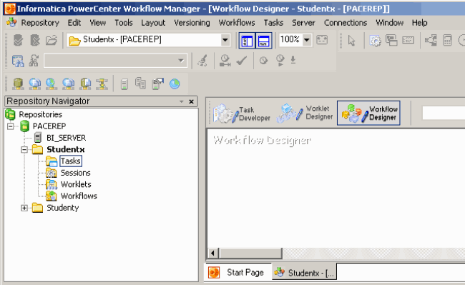
Workflow Designer
Workflow Designer: This is used for creating workflows.
Notes:
The Workflow Designer is used to create and edit workflows, which are the executable jobs in the Informatica PowerCenter. They consist of different tasks and / or worklets.
Go to the Workflows Menu, select Create, and then specify a workflow name in it. A Start task is already included in the workflow by default, which allows you to add or create one or more tasks developed in the Task Developer within the workflow.
To edit the workflow, you have to select the Workflow Menu and then the Edit option within it. You can also use the scheduler to execute the workflow as per a certain schedule.

Slide 27
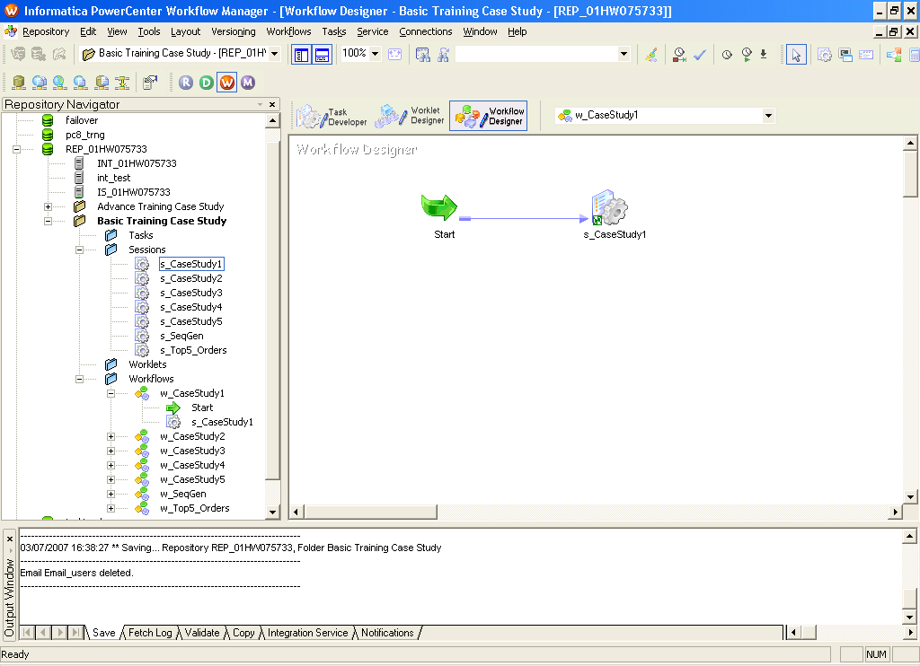
Workflow Structure
A Workflow is set of instructions for the Integration Service to perform data transformation and load
Combines the logic of Session Tasks, other types of Tasks and Worklets
The simplest Workflow is composed of a Start Task, a Link and one other Task
Link
Session Task
Start Task
Notes:
A start task is by default put in a workflow as soon as you create it. A start task specifies the starting task of the workflow i.e. a workflow run starting from the start task.
The tasks are linked through a ‘link Task’ which specifies the ordering of the tasks one after another or parallel as required during the execution of the workflow.

Slide 28


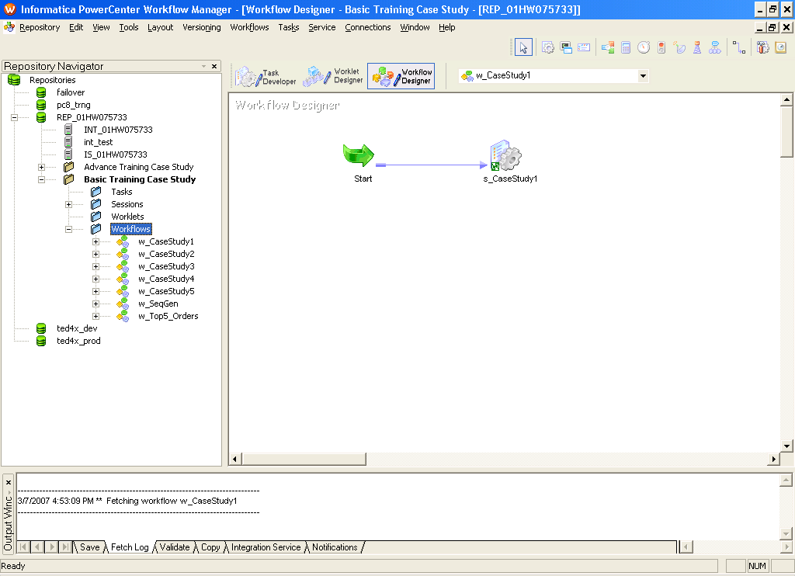
Additional Workflow Components
Two additional components are Worklets and Links
Worklets are objects that contain a series of Tasks
Links are required to connect objects in a Workflow
Notes:
Title and Content Slide – Font: Tahoma 12/14 (depending on the amount of text)
Heading: Calibri Heading 26 (consistent)
Bullet code – 174 for bullet
OOBB for sub bullet

Slide 29
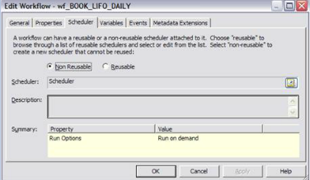
Scheduling a Workflow
In order to schedule a workflow, the workflow has to be opened in the Workflow Designer. Once done, the following steps has to be followed:
Click on Workflows > Edit and select “Scheduler” tab.
In the scheduler tab, select “Non-reusable” to create a non-reusable set of scheduler settings for the workflow. Or select “Reusable” to use an existing reusable scheduler for the Workflow
For “Non-reusable” scheduling, dick the right side of the scheduler field to edit the scheduling settings
For “Reusable” scheduling, choose a reusable scheduler from the scheduler browser dialog box.
Notes:
In order to schedule a workflow, the workflow has to be opened in the Workflow Designer. Then select the Scheduler tab. In the Scheduler tab, select the Non-reusable option to create a non-reusable set of schedule settings for the workflow, or select the Reusable option to use an existing reusable scheduler for the workflow. For Non-reusable scheduling, click the right side of the Scheduler Field to edit scheduling settings. On the other hand, for Reusable scheduling, choose a reusable scheduler from the Scheduler Browser dialog box.

Slide 30
PowerCenter Workflow Monitor
The Workflow Monitor is the PowerCenter tool which is used to monitor the execution of workflows and tasks.
Workflow Monitor can be used to:
View details about a workflow or task run in Gantt chart view or task view
Run, stop, abort, and resume workflows or tasks
The Workflow Monitor displays workflows that have run at least once.
The Workflow Monitor continuously receives information from the Integration Service and Repository Service. It also fetches information from the repository to display historic information.
Notes:
The Workflow Monitor is the client component of the PowerCenter. It is used to monitor the execution of workflows and tasks. A Workflow Monitor can be used to analyze the details about a workflow or a task run in the Gantt Chart view or task view. It is also used to run, stop, abort, and resume workflows or tasks.
It is important to remember that the Workflow Monitor displays workflows, which have run at least once. It continuously receives information from Integration Service and Repository Service to display the execution status of such workflows.

Slide 31
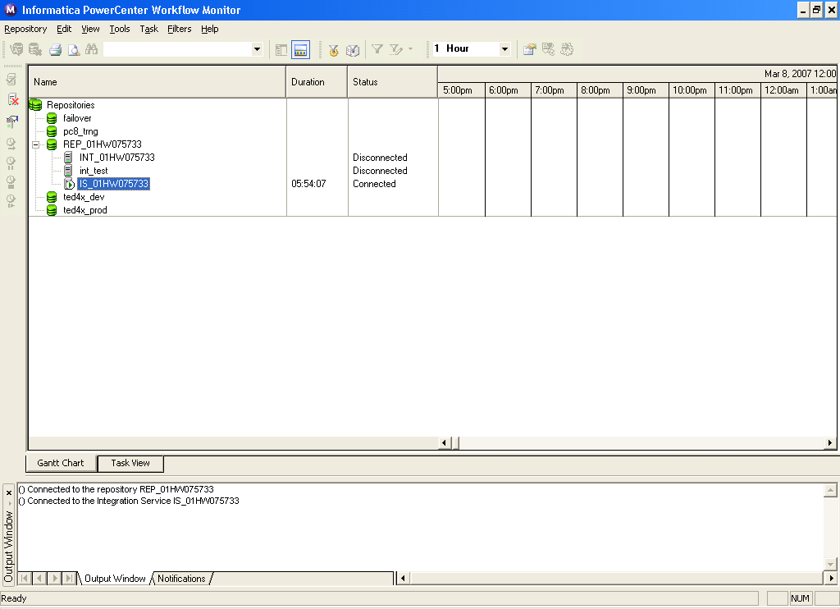
Overview of Workflow Monitor
Notes:
Title and Content Slide – Font: Tahoma 12/14 (depending on the amount of text)
Heading: Calibri Heading 26 (consistent)
Bullet code – 174 for bullet
OOBB for sub bullet

Slide 32
Opening Workflow Monitor
To open the Workflow Monitor, go to:
Start>All Programs>lnformatica PowerCenter 9.5.1>Client>PowerCenter Client > PowerCenter Workflow Monitor
The monitor can also be opened:
From the Workflow Manager Navigator
The Workflow Manager can be configured to open the Workflow Monitor when a workflow is run from the Workflow Manager
From Tools > Workflow Monitor in the Designer, Workflow Manager, or Repository Manager
Or, from the Workflow Monitor icon on the Tools toolbar
Notes:
Title and Content Slide – Font: Tahoma 12/14 (depending on the amount of text)
Heading: Calibri Heading 26 (consistent)
Bullet code – 174 for bullet
OOBB for sub bullet

Slide 33
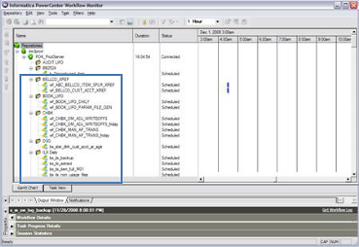
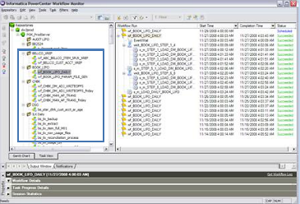
Workflow Monitor Views
Select the workflow in Gantt Chart View or Task View as illustrated below:
Notes:
After connecting to the Integration, the Navigator window will appear and show the list of all the folders and scheduled workflows. Its service is to select the Gantt Chart View or the Task View.t

Slide 34
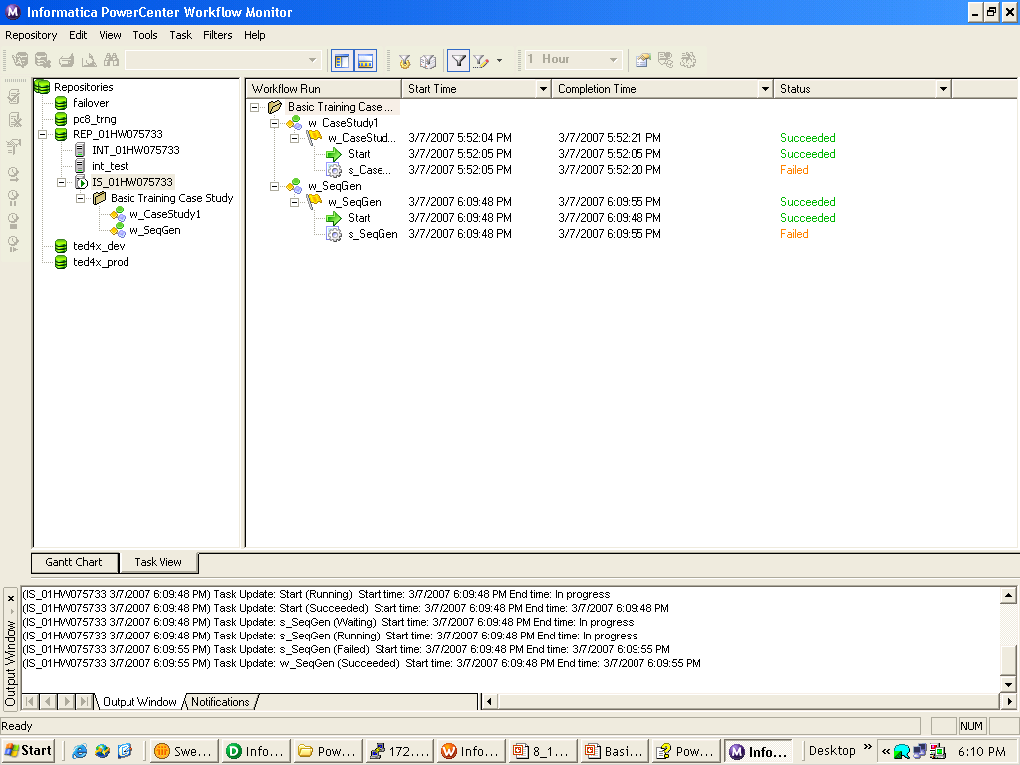
Different sections of Workflow Monitor
Task View
Workflow
Start Time
Completion Time
Status
Status Bar
Notes:
The Workflow Monitor consists of the
following windows.
1. The Navigator window displays the Repositories, Integration Services and repository objects.
2. The Output window displays messages from the Integration Service and the Repository Service.
3. The Properties window exhibits the details about the services, workflows, worklets, and tasks.
4. The Time window displays progress of workflow runs while the Gantt Chart view shows details about workflow runs in a chronological format, which is called a Gantt Chart.
5. The Task View window illustrates details about workflow runs in a report format, organized by the workflow run.

Slide 35
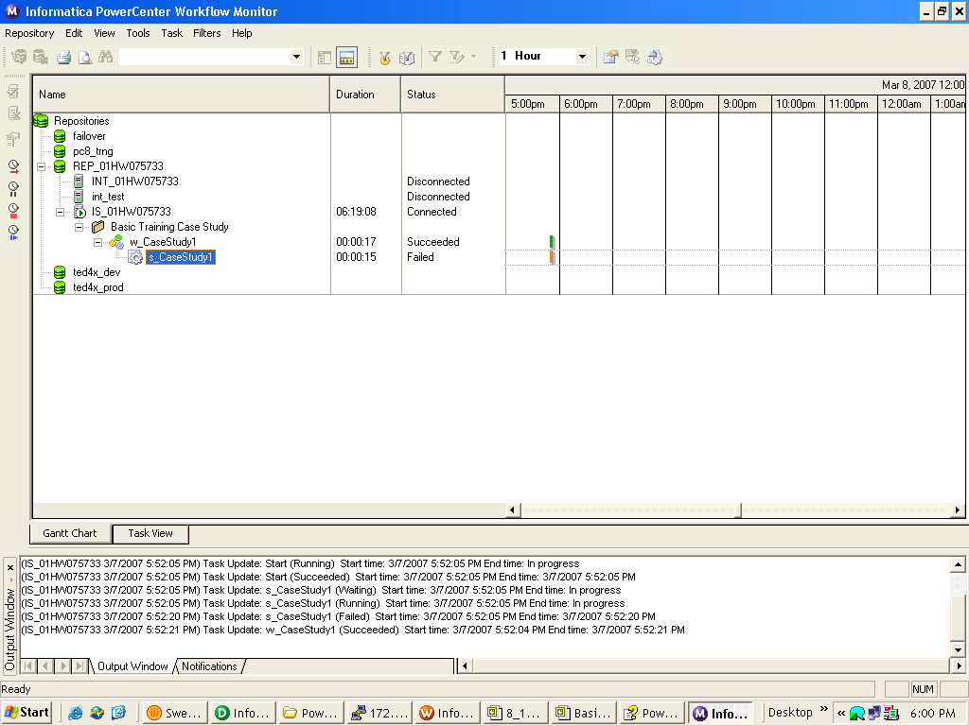
Monitoring Workflows
The following are the initial steps to monitor workflows:
Open the Workflow Monitor
Connect to the repository containing the workflow
Connect to the integration service
Select the workflow to be monitored
Select Gantt Chart view or task view
The Workflow Monitor display can be customized by configuring the maximum days / workflow runs the Workflow Monitor displays.
There is also an option to filter Task and Integration Services in both Gantt chart view as well as task view.
Notes:
Title and Content Slide – Font: Tahoma 12/14 (depending on the amount of text)
Heading: Calibri Heading 26 (consistent)
Bullet code – 174 for bullet
OOBB for sub bullet

Slide 36

Monitoring Workflows
Perform operations in the Workflow Monitor
Restart - restart a Task, Workflow or Worklet
Stop - stop a Task, Workflow, or Worklet
Abort - abort a Task, Workflow, or Worklet
Recover - recovers a suspended Workflow after a failed Task is corrected from the point of failure
View Session and Workflow logs
Abort has a 60 second timeout
If the Integration Service has not completed processing and committing data during the timeout period, the threads and processes associated with the Session are killed
Notes:
Title and Content Slide – Font: Tahoma 12/14 (depending on the amount of text)
Heading: Calibri Heading 26 (consistent)
Bullet code – 174 for bullet
OOBB for sub bullet

Slide 37
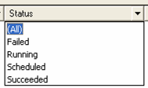
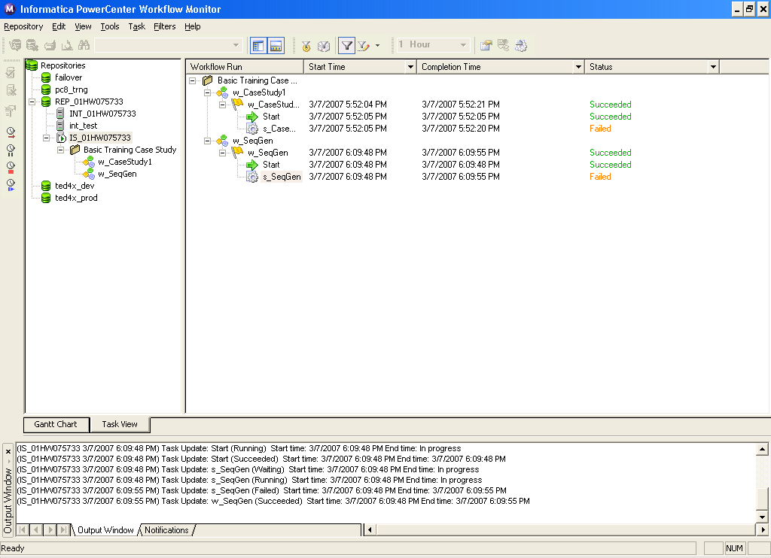
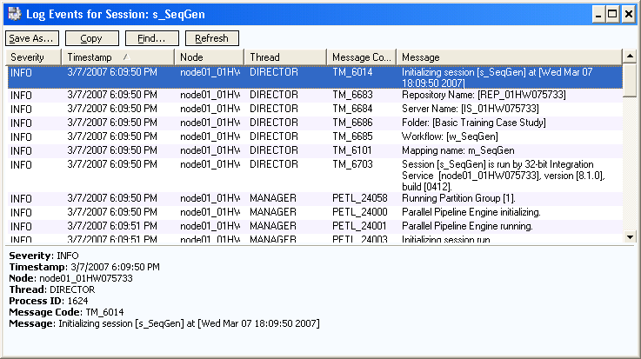
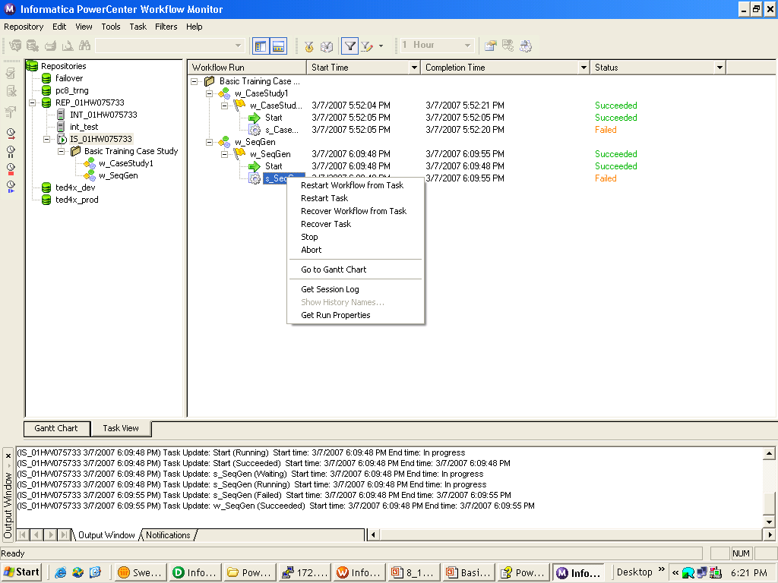
Monitoring Workflows (Contd.)
Monitor Window Filtering
Get Session Logs (right click on Task)
Monitoring filters can be set using drop down menus
Minimizes items displayed in Task View
Task View provides filtering
Right-click on Session to retrieve the Session Log
(from the Integration Service to the local PC Client)
Notes:
The session logs can be retrieved through workflow monitor. Reading the session log is one of the most important and effective way to determine the session run and to know where it has gone wrong. The session log specifies all the session related information as database connections, extraction information and loading information.
To filter tasks:1.Click Filters > Tasks.
-or-
Click Filters > Deleted Tasks.
The Filter Tasks dialog box appears.2.Clear the tasks you want to hide, and select the tasks you want to view. 3.Click OK.Note: When you filter a task, the Gantt Chart view displays a red link between tasks to indicate a filtered task. You can double-click the link to view the tasks you hid.

Slide 38
Aggregator
Overview
Calculates aggregates such as sums, averages, minimums and maximums, across multiple groups of rows
The aggregator transformation ,unlike the Expression transformation, can be used to perform calculations on groups
Active Transformation
Business Purpose - Enables calculation of gross profits or margins, summaries by period, average values, etc.
Notes:
Title and Content Slide – Font: Tahoma 12/14 (depending on the amount of text)
Heading: Calibri Heading 26 (consistent)
Bullet code – 174 for bullet
OOBB for sub bullet

Slide 39
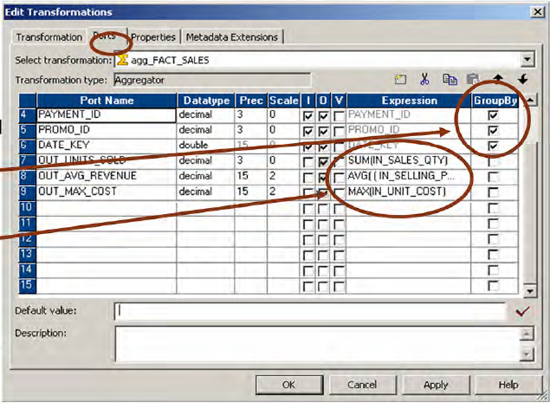
Aggregator (Contd.)
Ports
Mixed I/O ports allowed
Variable ports allowed
Group By allowed
Create aggregate expressions in
non-input ports
Usage - Standard aggregations
Notes:
Title and Content Slide – Font: Tahoma 12/14 (depending on the amount of text)
Heading: Calibri Heading 26 (consistent)
Bullet code – 174 for bullet
OOBB for sub bullet

Slide 40
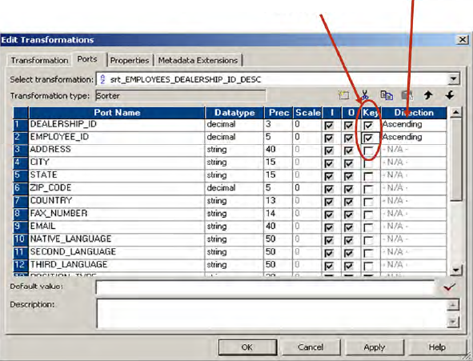
Sorter
Sort Keys
Sort Order
Sorter transformation is an active and connected transformation
Sorts incoming data based on one or more key values.
Sort order may be ascending, descending, or mixed.
The Sorter transformation is often more efficient than a sort performed on a database with an ORDER BY clause
Can sort data from relational or flat file sources.
The Sorter transformation can be used to sort data passing through an Aggregator transformation configured to use sorted input.
Can be configured for case-sensitive sorting, and specify whether the output rows should be distinct.
Notes:
Title and Content Slide – Font: Tahoma 12/14 (depending on the amount of text)
Heading: Calibri Heading 26 (consistent)
Bullet code – 174 for bullet
OOBB for sub bullet

Slide 42

Notes:
Transformation is the process in ETL where you actually apply the business rules in the data flow. In PowerCenter, transformations are the functional components.
There are a number of transformations available here that have a wide range of functionalities to meet almost all kinds of requirements.

